Slide 1
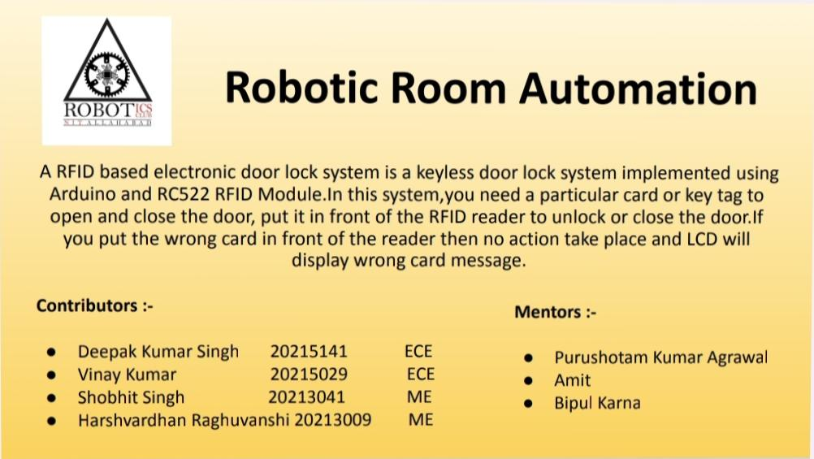

Slide 2


Slide 3
COMPONENTS USED:-
Arduino NANO
RFID Reader(RC522)
Rfid Tags
16×2 LCD Display and I2C module
Servo Motor (mg995)
Jumper wires
Bread board
IC 78055V
power supply

Slide 4
WORKING OF BOT:-
RFID SYSTEM:
RFID reader
RFID tag or smart label
An antenna
2. Arduino authorisation
3.Servo motor rotation and the door lock
4.Manual override functionality

Slide 5
FLOW CHART:-
Rfid tags
Rfid reader
LCD Display
Servo motor
Door lock
To unlock the door, a specific card or key tag is required, which must be presented to the RFID reader.
The tags contain unique electronically stored information, which is read by the rfid reader.
It will display the message whether the door is open or door is closed
The servo motor is attached to the doorknob in a way that allows it to rotate and open or close the door according to the circumstances.
Once the Arduino confirms the tag's authorization, it sends a signal to the servo motor.
The servo motor then rotates.

Slide 6
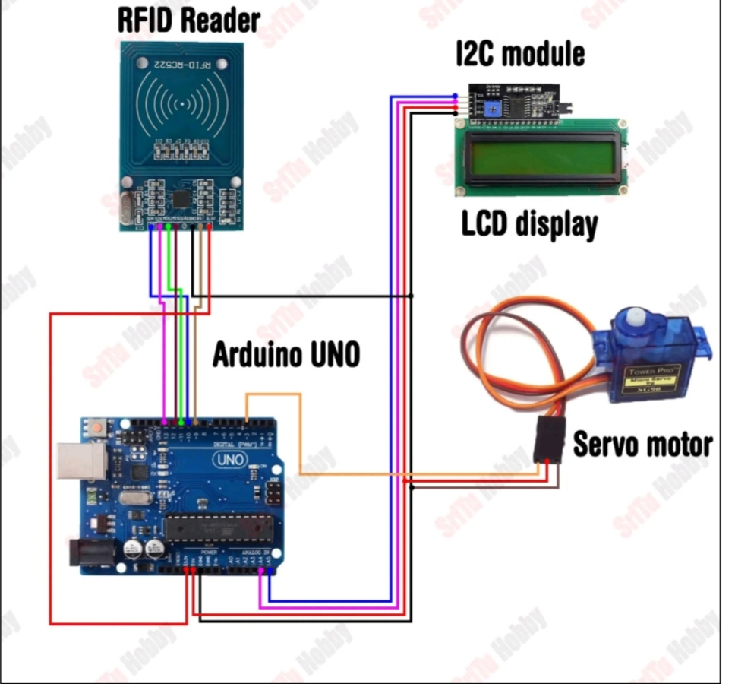
CIRCUIT DIAGRAM:-

Slide 7
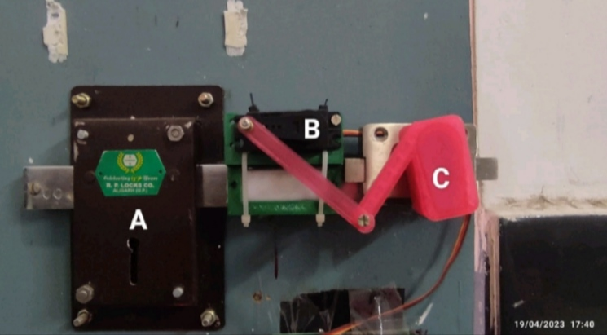
Door lock system:-
A : Door lock for manual override. it's a retractable system, when key is applied the whole servo+door lock system will be retracted.
B : Servo Motor
C : 3-D printed module which connects the servo motor with the handle of the door lock.

Slide 8


